Slide 1
The Sunny Side of Life
Notes:
Instructor:
Read through the whole lesson (including all the notes) before the day of class
Make note of and gather any supplies you need to bring
Prepare examples, stories
Think through how much time you want to spend on individual activities; make notes
Be sure to allow time to announce the assignment at the end
Overview:
Intro (slides 1-4): 3-5 minutes
Optimism (slides 5-21): 25-35 minutes
Gratitude (slides 22-32): 10-15 minutes
Wrap-up (slides 33-35): 2-3 minutes
Total: 40-58 minutes

Slide 2
Review
Explore the concept of confidence
Explore the concept of humility
Discuss the balance between the two concepts
Self-assess your place on the Humility-Confidence spectrum

Slide 3
Review
In lesson 10 we discussed a few ways to live the good life. Do you recall the approaches we discussed?
Live
Laugh
Love
Balance

Slide 4
Today
Objectives:
Understand optimism and how to increase it
Discuss the benefits of gratitude

Slide 5
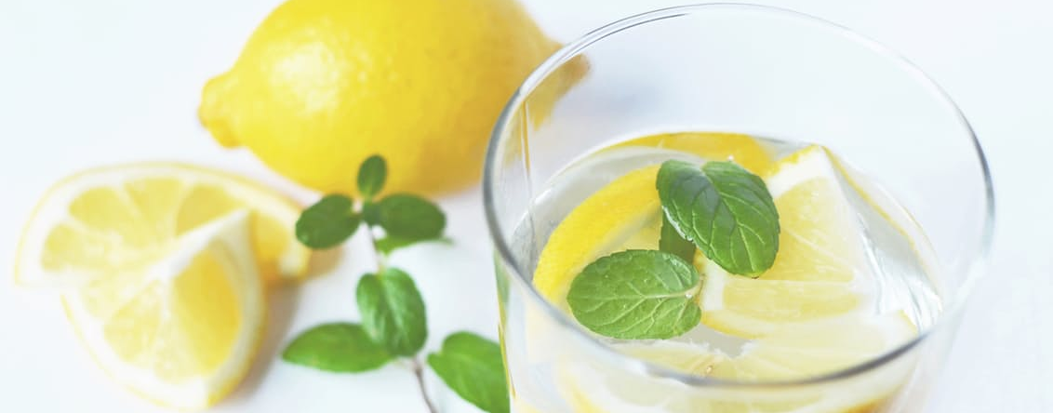
Optimism
Notes:
Image from https://www.pexels.com/photo/water-drink-fresh-lemons-3303/ CC0 license
Overview:
Intro (slides 1-4): 3-5 minutes
Optimism (slides 5-21): 25-35 minutes
Gratitude: 10-15 minutes
Wrap-up: 2-3 minutes
Total: 40-58 minutes

Slide 6
Take the Learned Optimism Test:
http://web.stanford.edu/class/msande271/onlinetools/LearnedOpt.html
Or this one: Are You an Optimist, Pessimist, or Realist?
http://www.quizony.com/are-you-an-optimist-pessimist-or-realist/index.html
Notes:
If the Learned Optimism test wasn’t completed as homework, do it now (takes about 10 minutes).
Calculate your scores at the bottom (but don’t pressure people to share)—based on each score, you’ll get a description—consider all comments together. Most likely, each person in the class is a blend of optimism and pessimism.

Slide 7

Reflect
Are you more optimistic or pessimistic?
Notes:
Image from unsplash.com

Slide 8
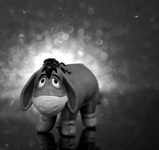
Pessimism
Pessimistic people see the glass as half-empty
They tend to be skeptical
They need proof
Scientific people are often in this group
Notes:
Image: Hancock, JD (2012). Extreme Eeyore. Retrieved from https://www.flickr.com/photos/jdhancock/7767340604
Definition of pessimism from http://glowballwebnetwork.com/difference-between-optimists-pessimists-and-realists/

Slide 9
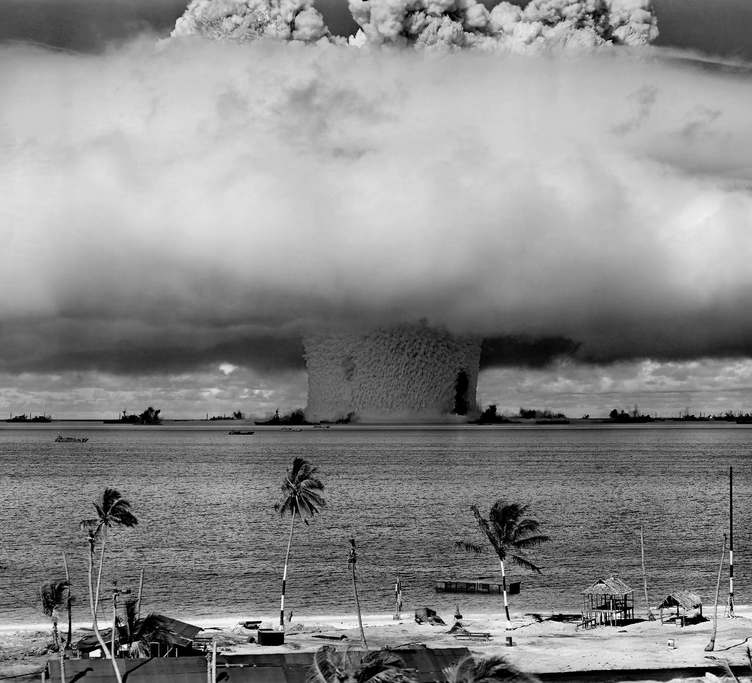
Fatalism
A fatalist expects the worst
Think Doomsday
Notes:
Image from https://www.pexels.com/photo/grayscale-photo-of-explosion-on-the-beach-73909/ CC0 license
Definition of fatalism from http://glowballwebnetwork.com/difference-between-optimists-pessimists-and-realists/

Slide 10
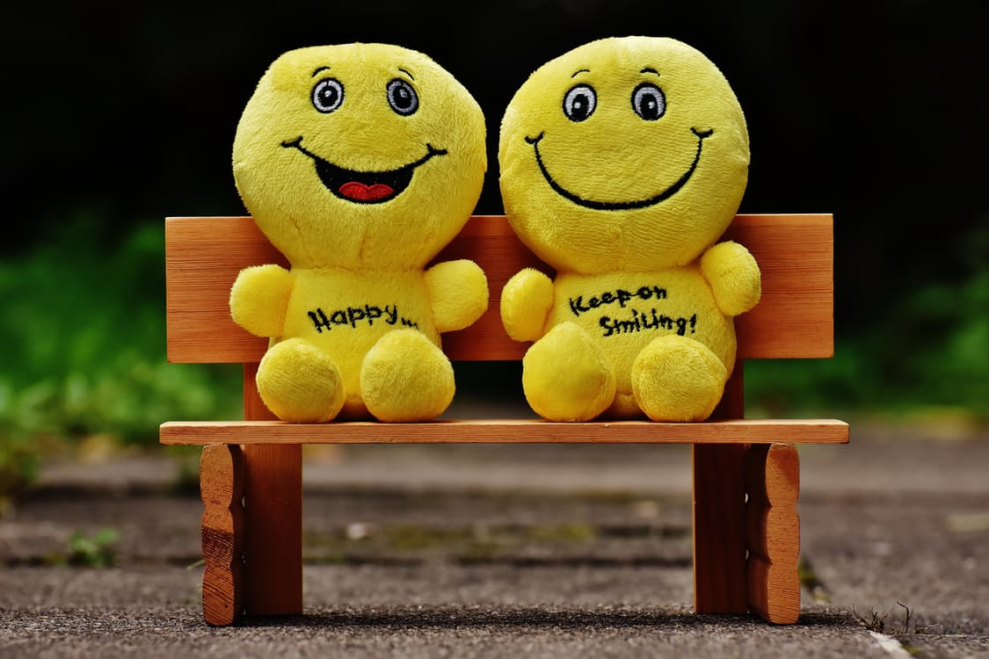
Optimism
Optimists generally expect a positive outcome
They may be considered gullible or naïve
Often, optimists are easily persuaded
Notes:
Image from https://www.pexels.com/photo/yellow-plush-toy-160739/ CC0 license
Definition of optimism from http://glowballwebnetwork.com/difference-between-optimists-pessimists-and-realists/

Slide 11

Realism
A realist sees things as they are
Focuses on the present
Pessimists often view realists as optimists; optimists often view realists as pessimists
Notes:
Image from unsplash.com
Definition of realism from http://glowballwebnetwork.com/difference-between-optimists-pessimists-and-realists/

Slide 12
Class Discussion
What are the advantages and disadvantages to each mindset (optimism, pessimism, realism)?
Notes:
Discuss in pairs, small groups, or as a class
(Write these specifics on the board)

Slide 13
Optimism Bias
About 80% of people have an optimism bias
We are optimistic about ourselves and our families
We tend to overestimate our abilities and positive qualities
We tend to underestimate the likelihood that we will divorce or have cancer
We’re somewhat pessimistic about others (e.g., we think bad things are more likely to happen to our neighbors than to us)
Notes:
Optimism Bias, Tali Sharot (2012). Retrieved from https://youtu.be/B8rmi95pYL0

Slide 14
Optimism Bias
Optimists expect better futures than do pessimists
Anticipation of good things enhances well-being
According to Tali Sharot, without optimism bias, we would all be slightly depressed
People who are slightly depressed are realists
People with severe depression have a pessimism bias
Notes:
Optimism Bias, Tali Sharot (2012). Retrieved from https://youtu.be/B8rmi95pYL0

Slide 15
Benefits of optimism
Success
Health
Greater longevity
Lower risk of chronic disease
Faster recovery from illness
Psychological Health
Reduced stress and anxiety
Increased ability to cope with difficulties
Quicker recovery from disappointments
Notes:
Sources: Tali Sharot (2012). Optimism Bias. Retrieved from https://youtu.be/B8rmi95pYL0
Pursuit of Happiness, Inc. (2016). Mindfulness and Positive Thinking. Retrieved from http://www.pursuit-of-happiness.org/science-of-happiness/positive-thinking/

Slide 16
Optimism Bias
The more optimistic you are, the less your brain responds to bad news
For example, optimists expect they have a 10% risk of getting cancer; after being told that 30% of people get cancer, the optimists think they have an 11% chance of getting cancer.
When might optimism be a good thing?
When might optimism be a bad thing?
Notes:
Optimism Bias, Tali Sharot (2012). Retrieved from https://youtu.be/B8rmi95pYL0

Slide 17
Explanatory Styles
Optimistic
I had a great date because I’m an interesting person.
On the other hand, failing my test was an isolated event and not really my fault.
Pessimistic
No one likes me, and that’s because I’m not interesting.
I succeeded because I got lucky.
Notes:
Optimists believe negative events are temporary, limited, and manageable, and that positive events are permanent, pervasive, and personal. Pessimists believe the opposite.
From Martin Seligman’s Learned Optimism

Slide 18
Learned optimism
Consciously challenge negative self talk
Practice using an optimistic explanatory style:
“What happened was
an unlucky situation (not personal),
and really just a setback (not permanent)
for this one goal (not pervasive).”
Notes:
If you are not naturally optimistic, you can learn to be optimistic.
On the next slide, we’ll practice with a few scenarios. You could write the example sentence on the board, or come back to this slide.
Source: Learned optimism. (2016) Retrieved from https://en.wikipedia.org/wiki/Learned_optimism

Slide 19
Practice
With a partner, take turns explaining each scenario, first in a pessimistic explanatory style, next in an optimistic explanatory style:
Scenario #1
You applied for 5 jobs, got 3 interviews, and 1 job offer.
Scenario #2
You haven’t been on a date in several weeks, but you just got asked out by someone you find interesting.
Scenario #3
You and your roommate keep fighting about the mess in your apartment.

Slide 20
Discuss
Can you change your mindset?
Should you try?

Slide 21
Summary
Optimism has several benefits
Unrealistic optimism can lead to poor planning and decision making
Hopeful realism might be the ideal

Slide 22
Gratitude
Notes:
Overview:
Intro (slides 1-4): 3-5 minutes
Optimism (slides 5-21): 25-35 minutes
Gratitude (slides 22-34: 10-15 minutes
Wrap-up: 2-3 minutes
Total: 40-58 minutes

Slide 23

“Gratitude is not only the greatest of virtues, but the parent of all the others.” -Cicero
Notes:
Image from https://www.pexels.com/photo/sunset-person-love-people-69096/ CC0 license

Slide 24

Reflect
Think of a time when someone expressed gratitude to you. How did you feel?
How do you feel when you express gratitude?
When was the last time you expressed gratitude?
Notes:
Image from https://www.pexels.com/photo/blue-calm-sea-95082/ CC0 license Brightness altered.

Slide 25
Exercise
Make a list of people and things you’re grateful for.
Share something you’re grateful for.
Expressing gratitude tends to make us even more grateful.
Notes:
Depending on time remaining, give everyone about 2 minutes to make their list.
Go around the room and have everyone share one thing (no repeats). Or (if you don’t have time to go around the room), have everyone share in small groups or pairs.

Slide 26

Notes:
About 1 minute (If you have less than 10 minutes left, you could skip this slide and the next)
The Importance of Thank You in Our Society
https://www.youtube.com/watch?v=56oVuzwfm0E
The video may take several seconds to load (it may help to advance a slide and then return to this one).

Slide 27
Discuss
How is “Thank you” used in our society?
What do you think about how we use “Thank you”?
Do we say it too much or not enough?
Notes:
2-5 minutes

Slide 28
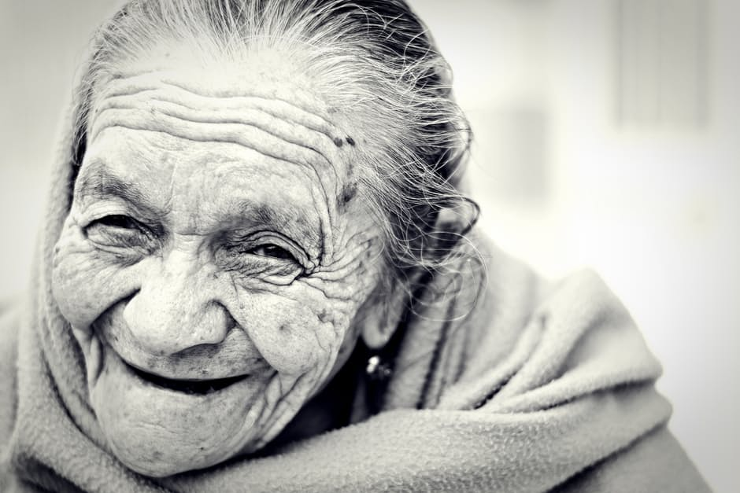
Benefits of Expressing Gratitude
Positive emotions
Improved health
Stronger relationships
Ability to deal with adversity
Tendency to relish good experiences
Notes:
Content: http://www.health.harvard.edu/healthbeat/giving-thanks-can-make-you-happier
Image: https://www.pexels.com/photo/black-and-white-old-person-woman-25181/

Slide 29
Gratitude Journals
In a study by Robert A. Emmons and Michael E. McCullough, participants were divided into three groups and assigned them to write a few sentences per week for 10 weeks.
Group 1 wrote about things they were grateful for during the week.
Group 2 wrote things that irritated or bothered them.
Group 3 wrote about events that had affected them.
Results:
“After 10 weeks, those who wrote about gratitude were more optimistic and felt better about their lives.
Surprisingly, they also exercised more and had fewer visits to physicians than those who focused on sources of aggravation.”
http://www.health.harvard.edu/healthbeat/giving-thanks-can-make-you-happier
Notes:
Feel free to summarize this rather than read it.

Slide 30

Thank You Notes
Martin Seligman tested the effect of various interventions on 411 participants
The intervention with the greatest impact:
Writing and personally delivering a letter of gratitude to someone that hadn’t adequately been thanked
Happiness scores increased enormously, and the benefit lasted months
Notes:
Content source: http://www.health.harvard.edu/healthbeat/giving-thanks-can-make-you-happier
Image: John-Mark Smith (2016). Retrieved from https://www.pexels.com/photo/person-holding-fountain-pen-211291/ CC0 license

Slide 31

Saying, “Thanks”
Individuals who thank their partner feel more positive toward the other person and more comfortable expressing concerns about their relationship.
Employees tend to work harder when managers thank them for their work.
Notes:
http://www.health.harvard.edu/healthbeat/giving-thanks-can-make-you-happier
Image: https://www.pexels.com/photo/man-in-red-white-and-blue-check-long-sleeve-shirt-beside-woman-in-black-and-white-stripes-shirt-hugging-each-other-while-sitting-on-a-concrete-surface-168426/ CC0 license

Slide 32

Challenge:
Choose a way to express gratitude this week
Say thanks every day
Keep a gratitude journal this week
Send someone a thank you note
Notes:
Image from https://www.pexels.com/photo/2-girls-hugging-each-other-outdoor-during-daytime-225017/ CC0 license

Slide 33
Review
Objectives:
Understand optimism and how to increase it
Discuss the benefits of gratitude

Slide 34
Additional Resources
The Power of Optimism, Bert Jacobs: https://youtu.be/yYGNWIT4eqA
Book review of Learned Optimism: https://youtu.be/2hHNq45rEnU
The Optimism Bias, Tali Sharot: https://youtu.be/B8rmi95pYL0
Mindfulness and Positive Thinking: http://www.pursuit-of-happiness.org/science-of-happiness/positive-thinking/
Learned Optimism: https://en.wikipedia.org/wiki/Learned_optimism

Slide 35

Content (not images or videos) copyright information:

